Slide 1
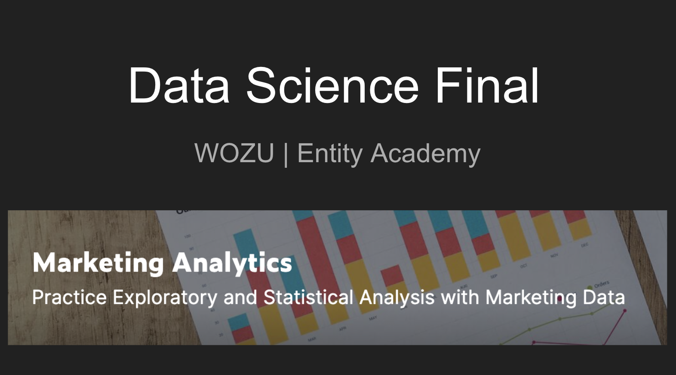

Slide 2


Slide 3
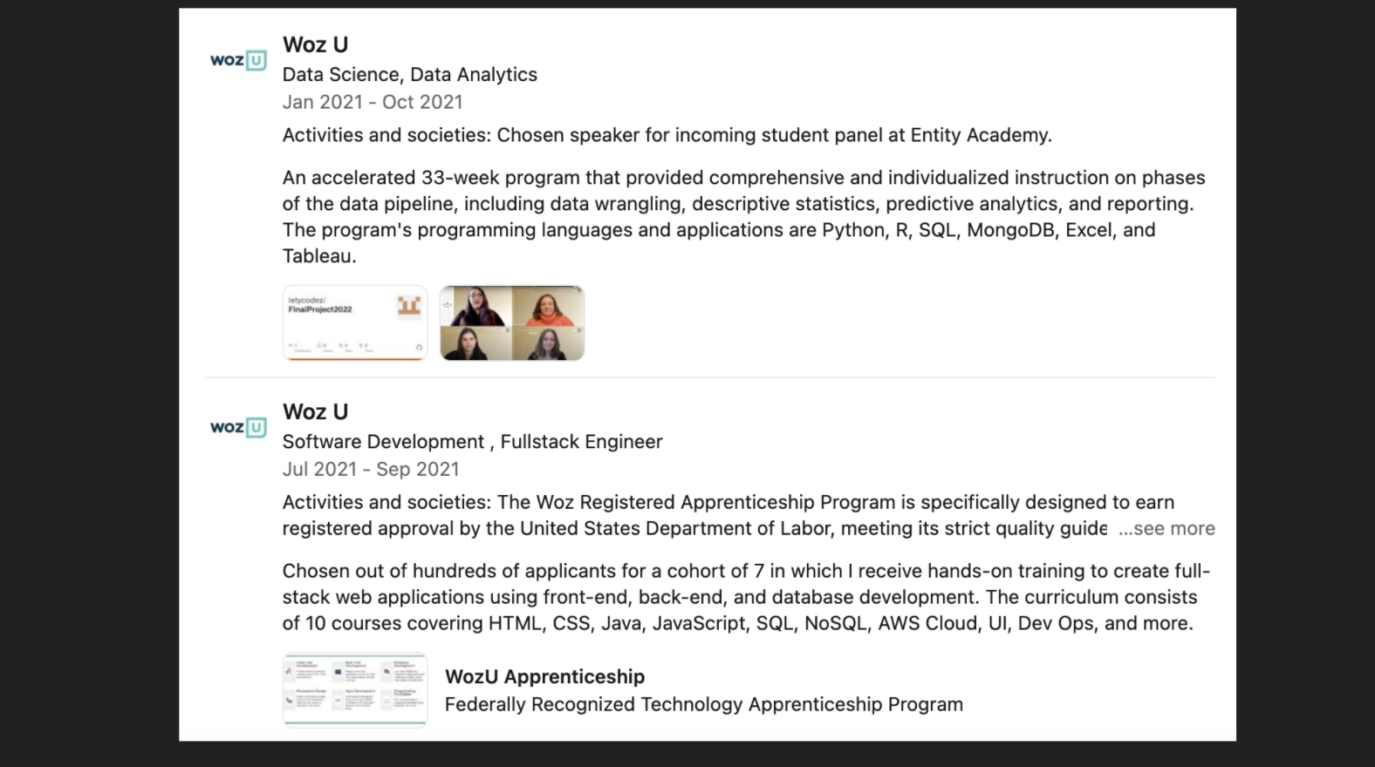

Slide 5
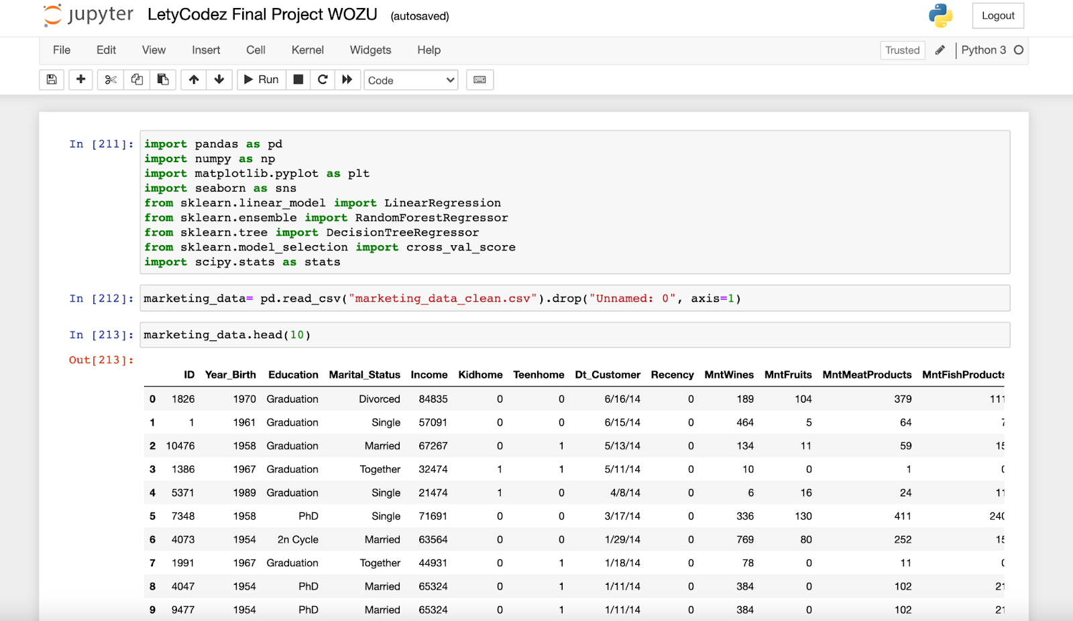
What type of data?
Notes:
So with my marketing degree, I decided to take a random data set for a company XYZ, to analyze and visualize data in order to create a story. At first glance, it seems like random data, however with exploration I am able to piece together a narrative for the Marketing team. For my presentation today we are looking at a .csv file of Marketing Data Set for XYZ company, Essentially, we have over 2,240 customers and 28 variables

Slide 6
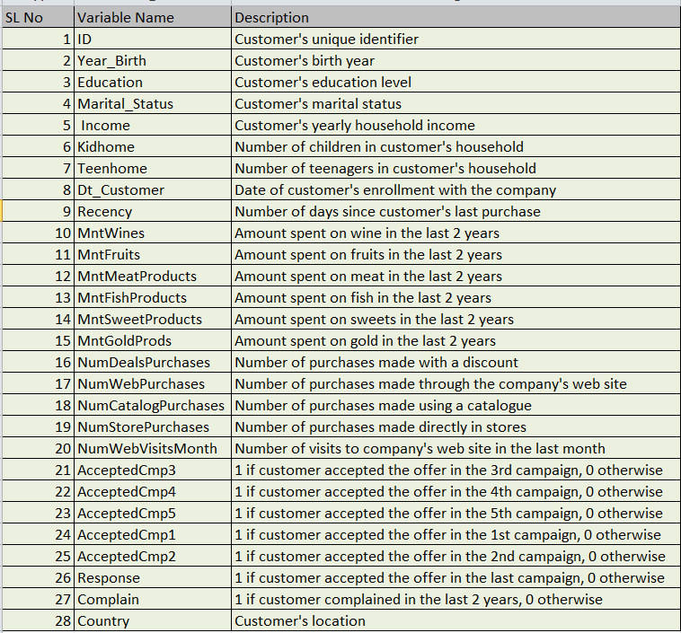
Notes:
This is a data set dictionary of all the contents. However, not all data was needed. I only applied the valuable relevant data.

Slide 7
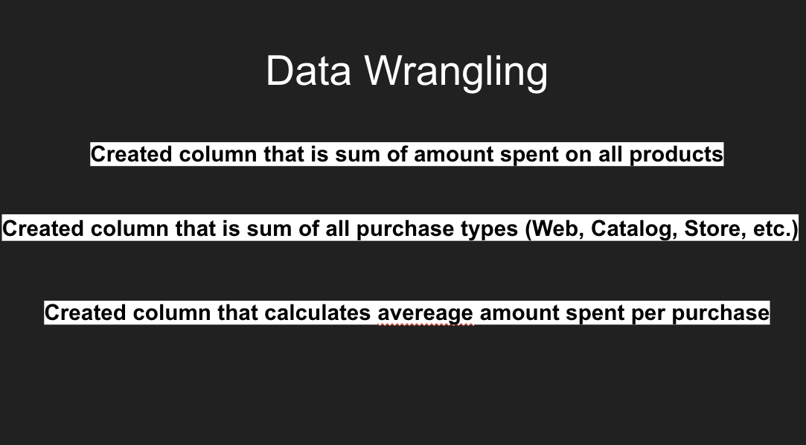

Slide 8
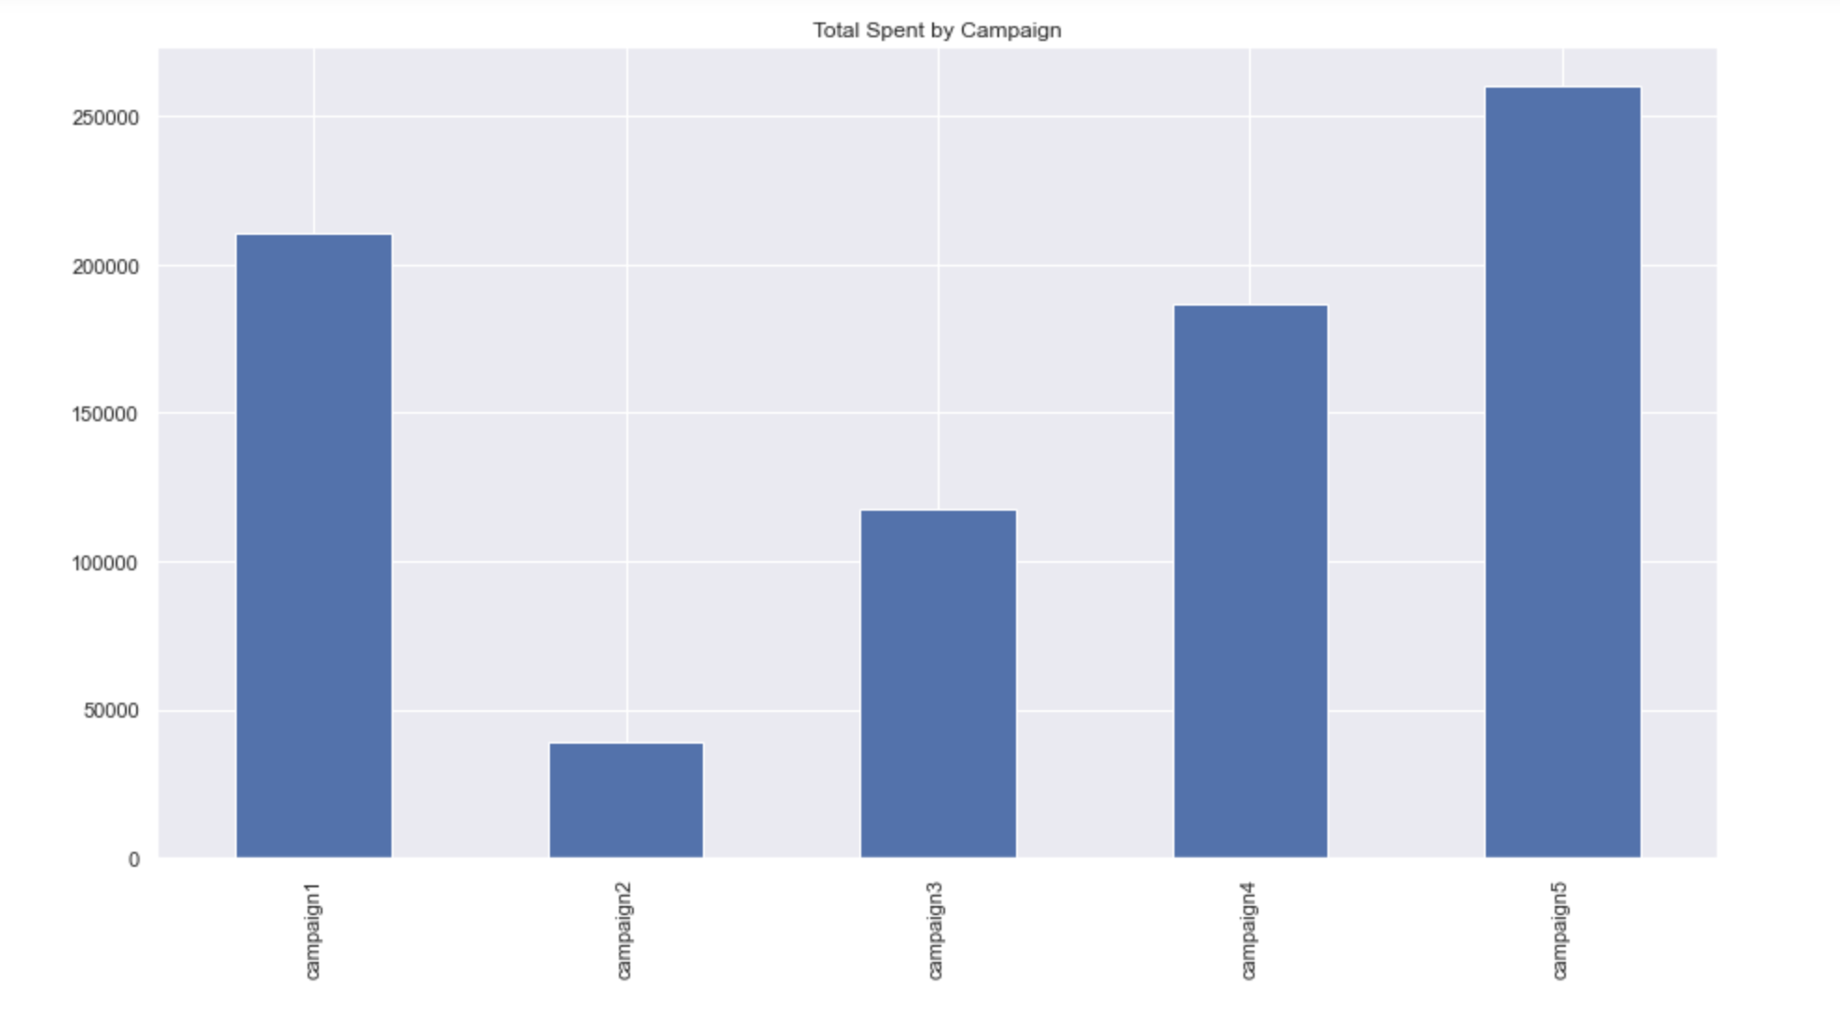
Notes:
Reason for campaign 2, was it a seasonal reason, or the method of outreach ( Social Media, Mail, Email etc.)

Slide 9
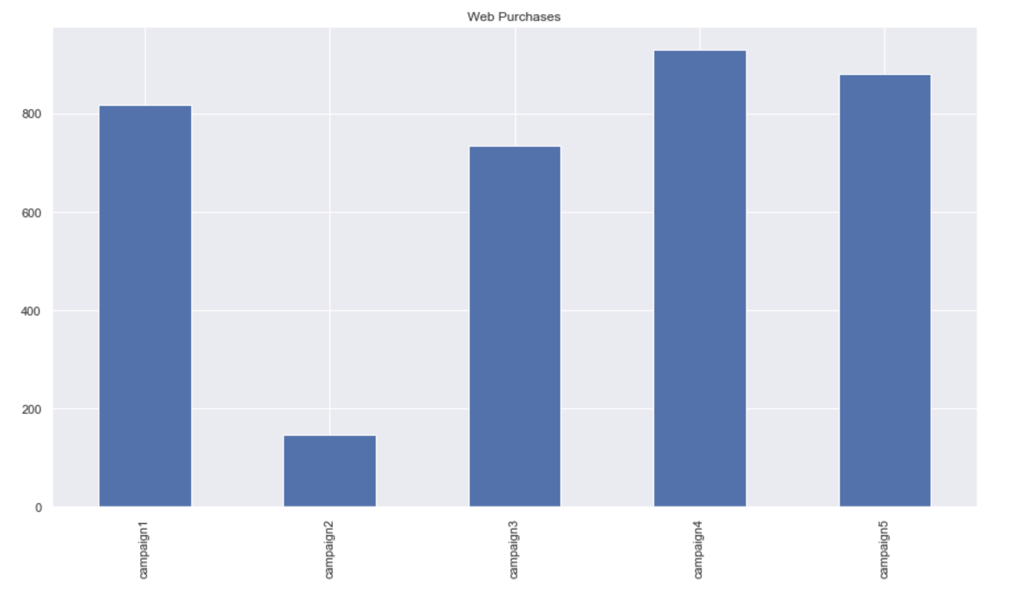
Notes:
So I looked into the campaigns and amount spent for a birdseye view of the web purchses during each campaign and all did relatively well compared to compaign 2, and so what elements were kept and or removed folloing campaign 2? Was this during a lull period, was this campaign via a different approach?

Slide 10
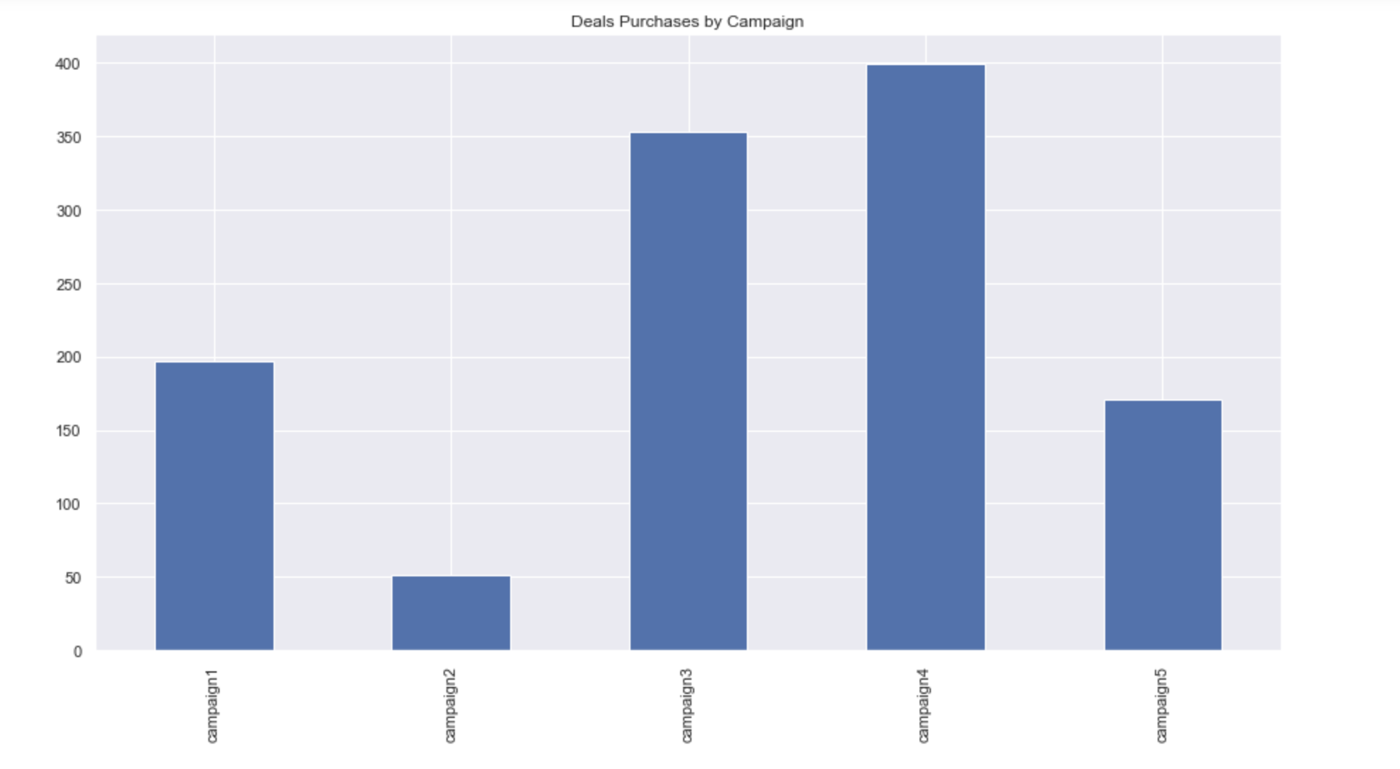
Notes:
Campaigns 3 and 4 were the most receptive to the deals and so when you take that into account, you are looking at the driving factors: What were the deals specifically? Was this a temporary Fear of Missing out deal, was this a deal with incentives to spend more, freee shipping etc.

Slide 11
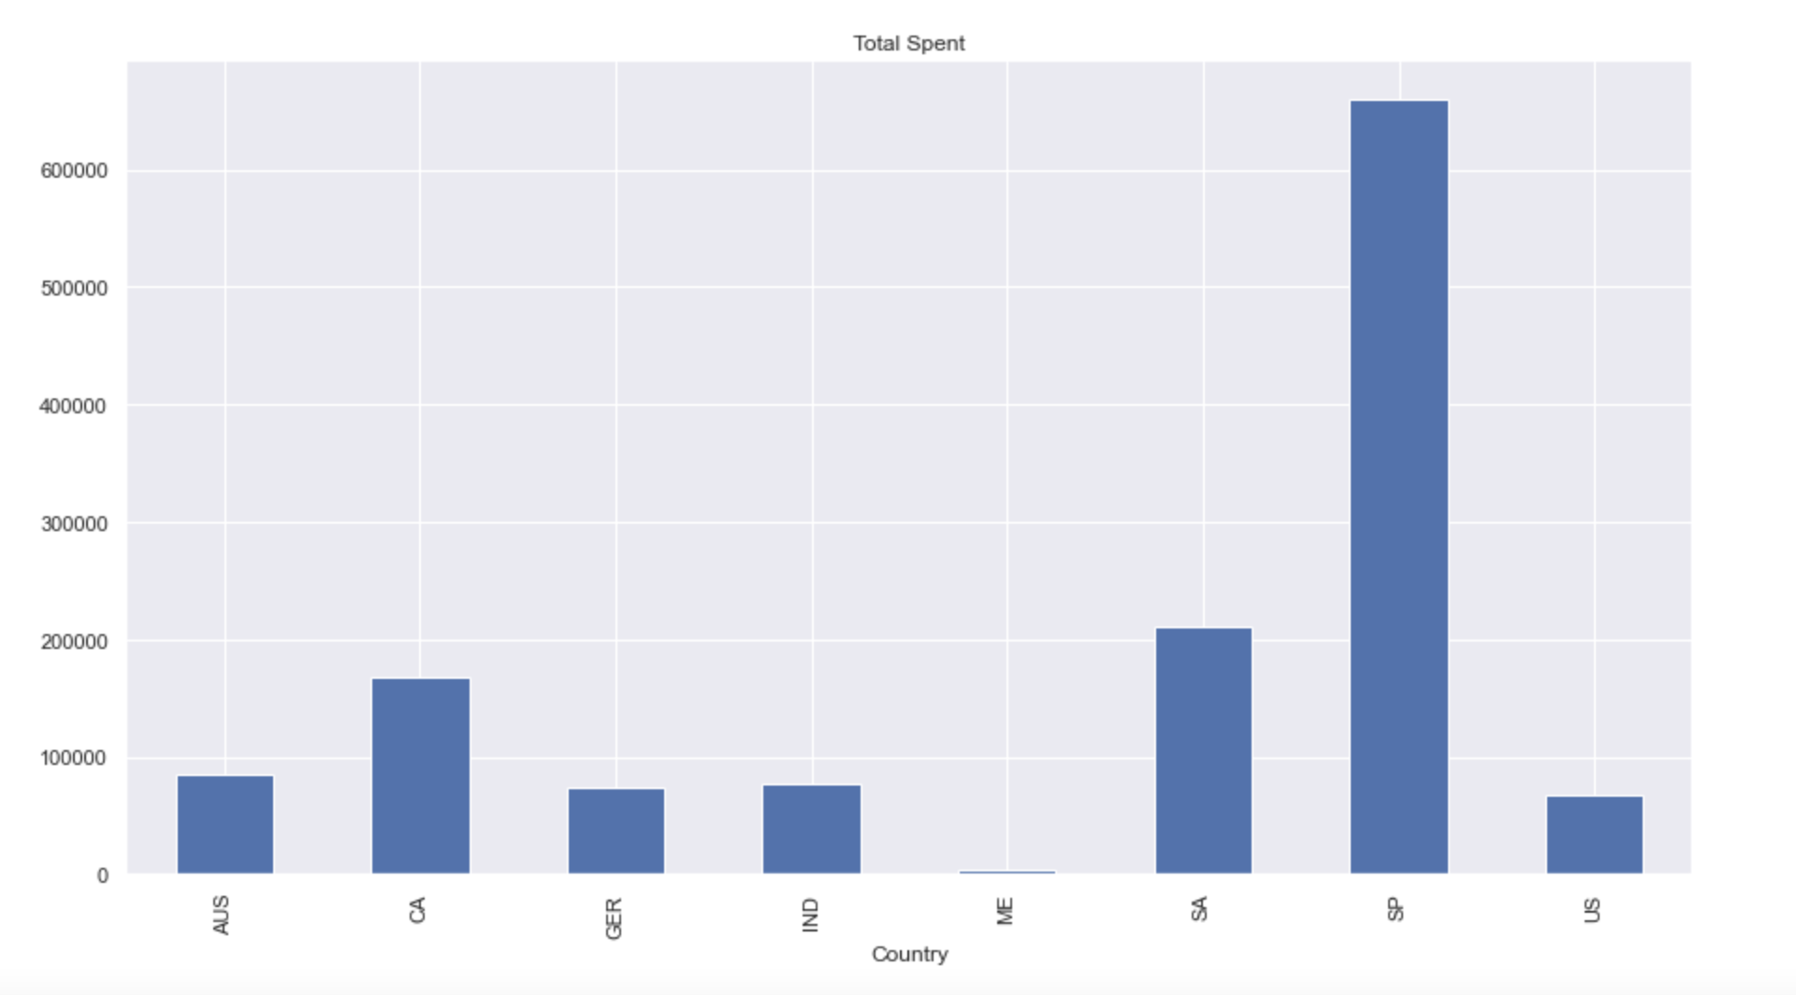
Notes:
Here we can see that Spain has the highest Total Spent. Could attributes such as language and culture be impacting the response of each country?

Slide 12
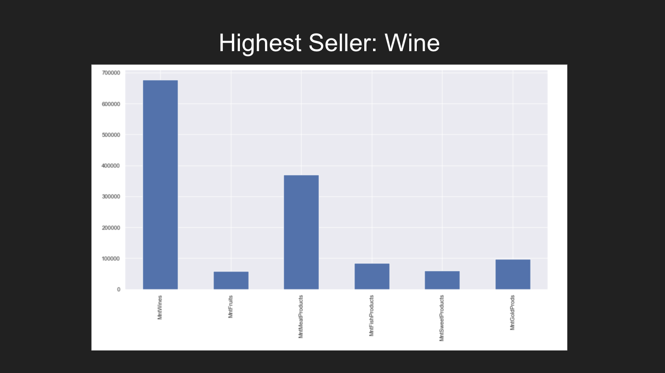
Notes:
Best selling product for the company was wine. So Spain loves wine.

Slide 13
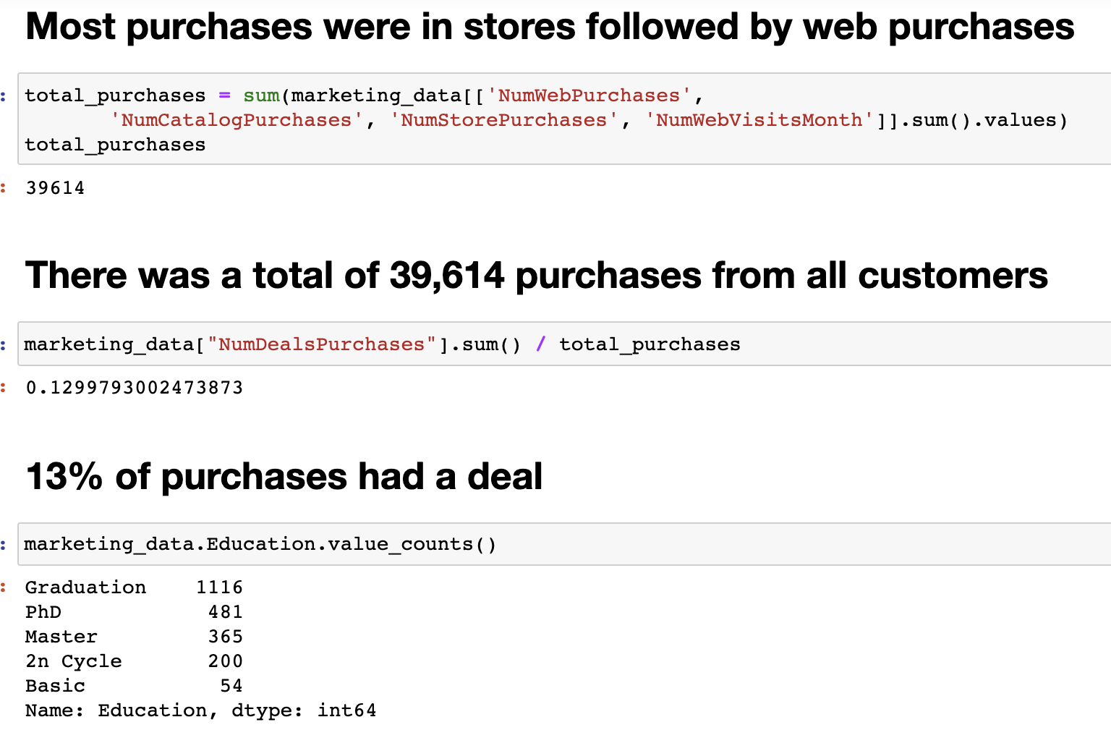
Notes:
So then I dove in a little deeper, on descriptive details on customer profiles. I tried to compare where the purchases were coming from. I took the demographics of Educated population and analyzed what group purchased most. People with higher education levels, purchased more,

Slide 14
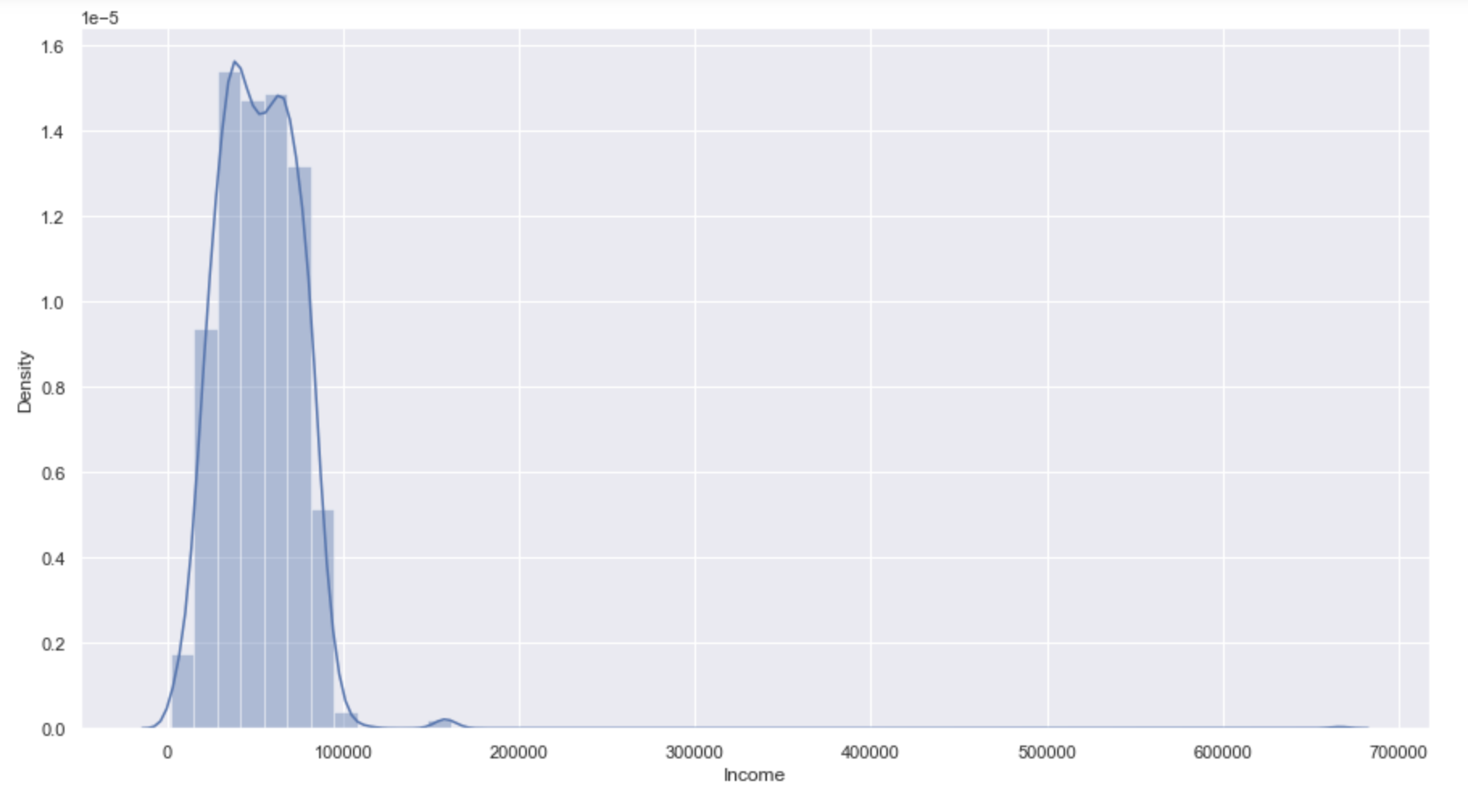
Notes:
Demographics of clientele income. Speak on outliers that were eliminated due to human entry error

Slide 15
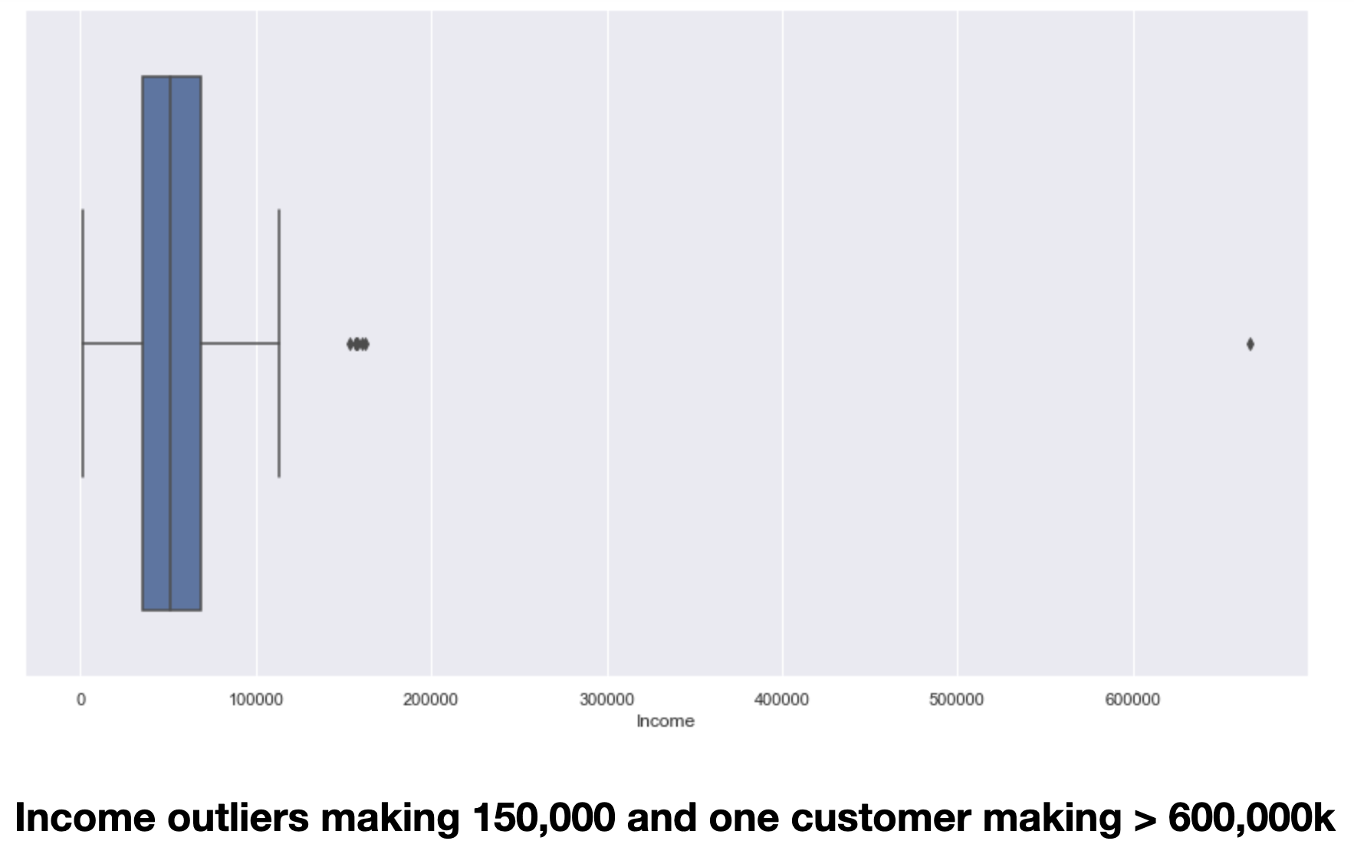
Notes:
With outlier, boxplot

Slide 16
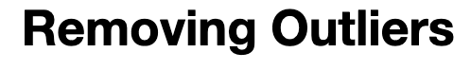
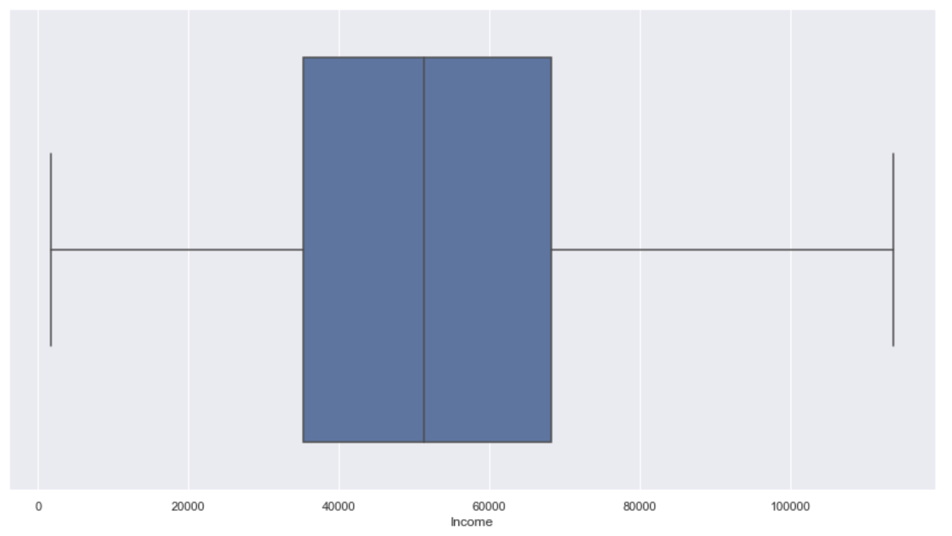
Notes:
We removed it and its symmetrical, more uniform

Slide 17
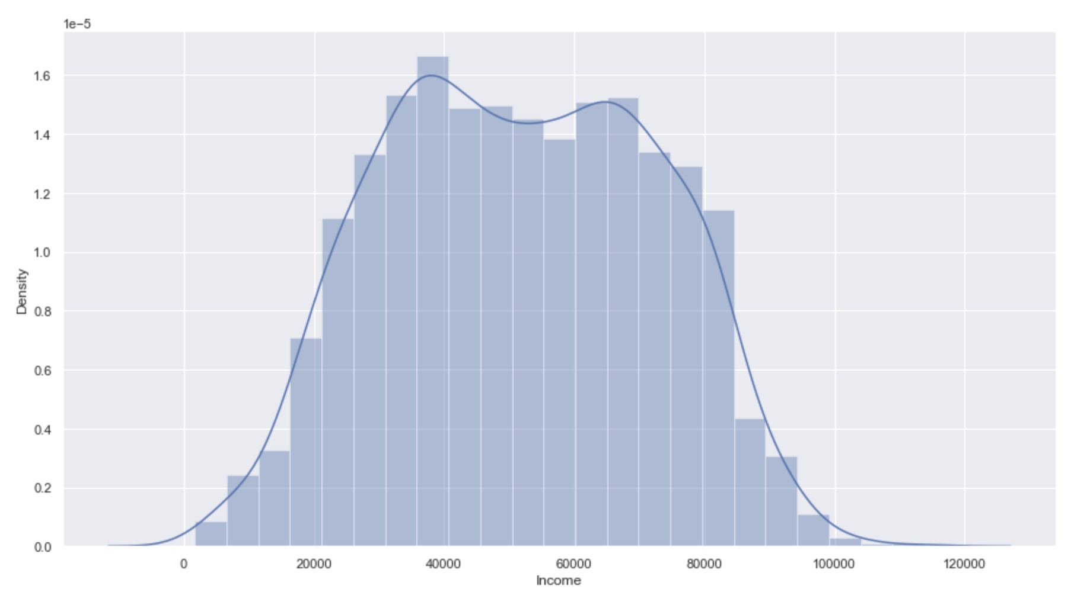

Slide 18
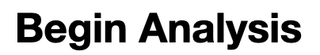

Slide 19
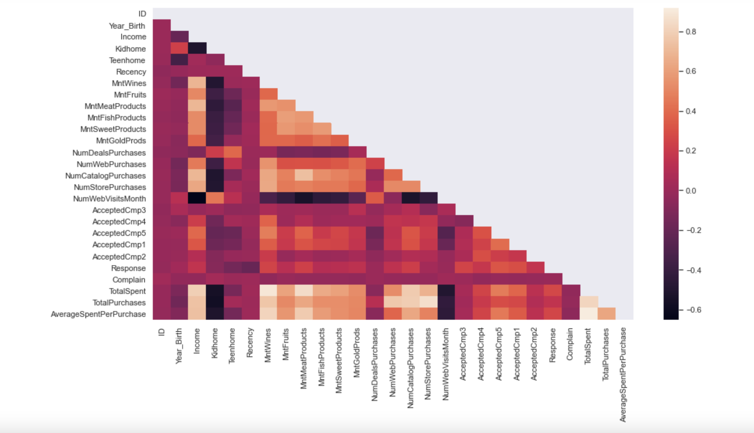
Notes:
Correlation Heatmap , masked top half for readability ….elaborate on the findings, for example more kids less $ spent on wine, (Darker=a negative correlation, and Lighter= Postive) So the more children, the less spent for example….VS higher income = higher amount spent on wine ::: this is great information to engineer the marketing campaigns and target the sales towards specific niche/consumer profiles/ target markets

Slide 20
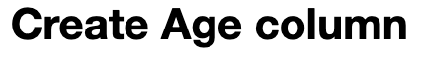
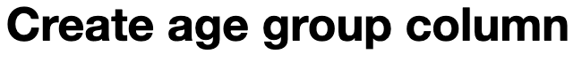
Data Prep Continued:

Slide 21
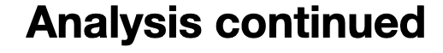

Slide 22
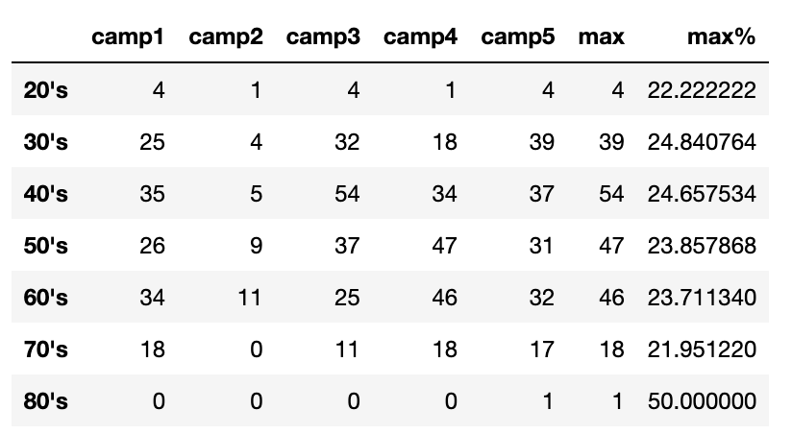

Slide 23
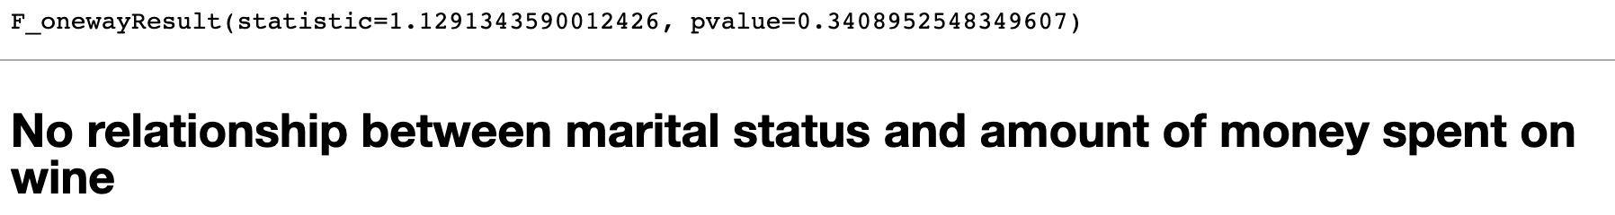
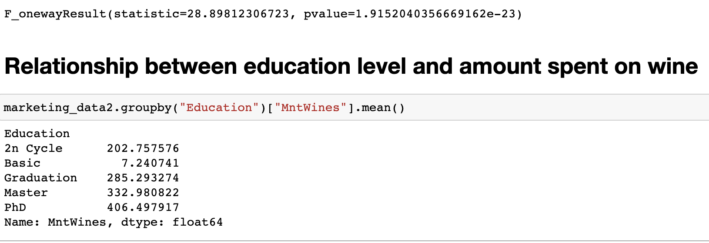
Anova Results

Slide 24
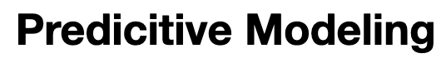
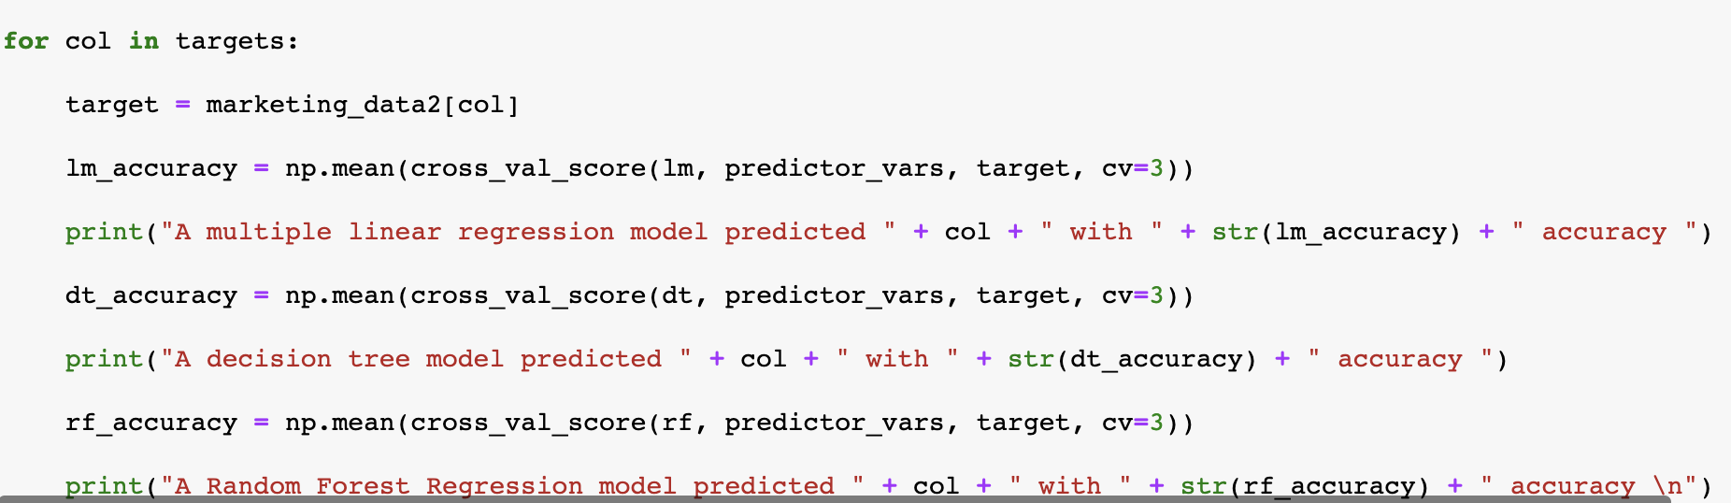
Notes:
Used for loop to trial linear regression models and Random Forest models using customer attributes "Education", "Marital_Status", "Income", "Kidhome", "Teenhome", "Age", and "Country” as independent variables to predict total amount spent, types of purchases, and amount spent on individual products types.

Slide 25
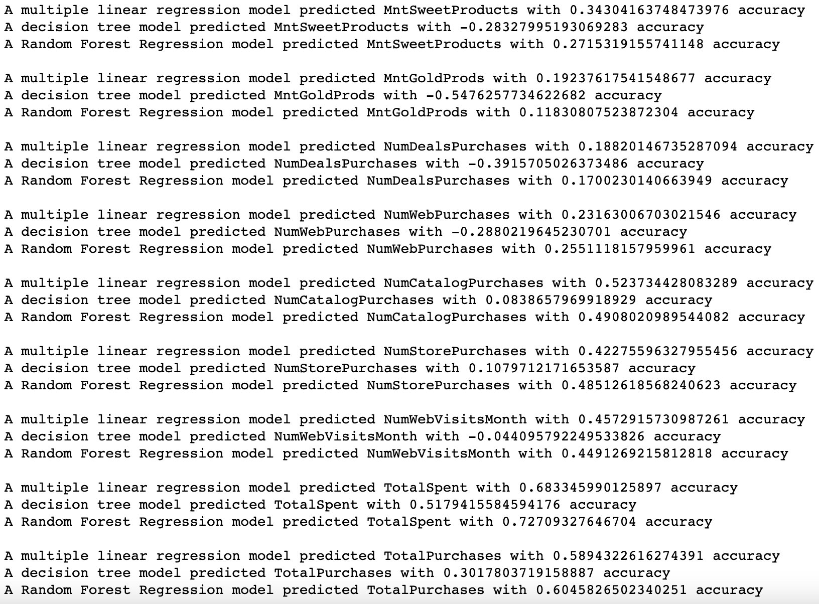

Slide 26
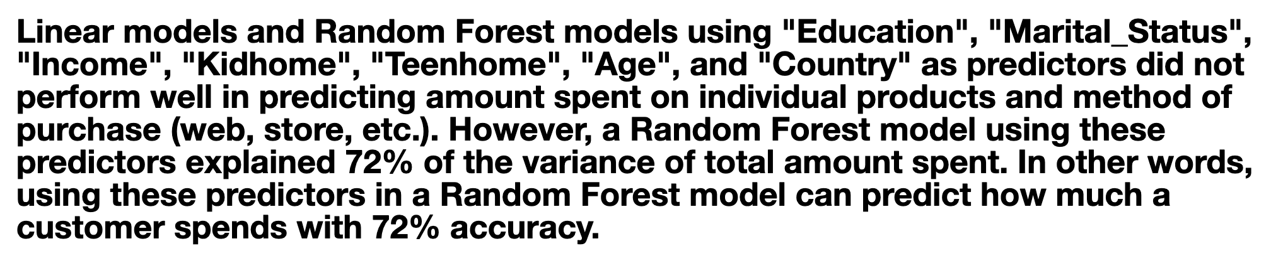
Notes:
In terms of machine learning : This prediction of how much the customer would spend is at 72% accuracy, so its necessary to collect more data for the predictive models to attain a higher accuracy. For future analysis, we can collect more insights on web, store or catalog purchases.

Slide 27
In conclusion…
Special THANK YOU!!!
Devin Moya, Dr. Meredith, Jennifer Schwab, Angelica Pronto
Notes:
Where to take into the future, value of exploring customer demographics, touch base more on the individual campaigns,

